Slide 1
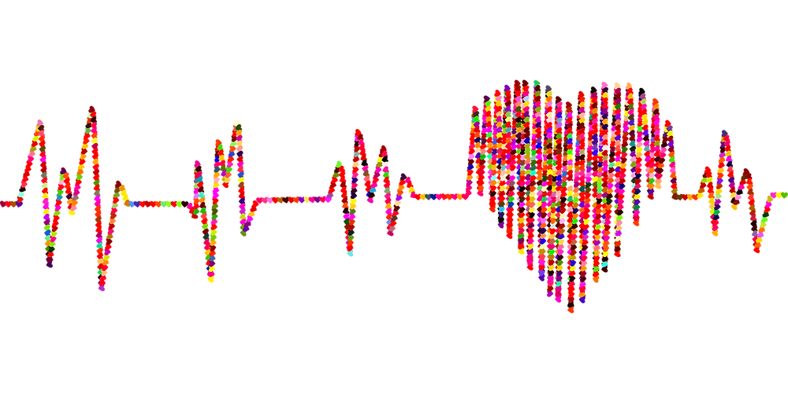
Data Analytics Bootcamp –UOT Final Project - Group 7
PREDICTION OF FACTORS LEAD TO HEART DISEASE

Slide 2
CONTENTS
Overview
Objective
What we used
Exploratory Data Analysis
Data Storage
Machine Learning Models
Dashboard
Conclusion
Our team

Slide 3
OVERVIEW :
According to the WHO, heart diseases are the leading cause of death globally. Approximately 17.9 million people die each year from heart diseases and estimated around 32% of all deaths worldwide. There have been identified many important factors which lead to heart disease. Identifying those risk factors and motivating people to adopt and following healthy behaviours is very important.

Slide 4
OBJECTIVE:
Our team use a heart disease dataset with different factors to predict which factors are at highest risk of leading to heart disease. Our team’s target audience would be the health care professionals as they will be able to apply the most current and up to date research and evidence to patient care and helping people preventing premature deaths related to heart diseases.

Slide 5
WHAT WE USED

Slide 6








Data Source and Resources | Technologies | Languages | Tools/Libraries | Algorithms/Settings
Resources: Click here https://www.kaggle.com/datasets?search=heart+disease. Data Source: heart_disease_key_indicators.csv |  |  |  | Linear Regression Random Forest Classifier Hyperparameter Optimization XgBoosting

Slide 7
EXPLORATORY DATA ANALYSIS

Slide 8

Analytical Questions
What are the key indicators that lead to heart disease ?
What factors had the greatest influence on a person developing heart disease and in what proportions ?
Can a machine learning model accurately predict whether a person will develop heart disease based on the data provided ?

Slide 9
Understand the Data
Importing libraries and files for exploratory data analysis
Clean the Data
Analysis of relationship between variables
Creating data frame and checking number of columns and rows.
Checking the data types.
Checking the data characters mistakes.
Checking the null values.
Checking and removing the duplicates.
Transforming the target variable.
Loading data
Target variable visualization
Other variable against target variable visualizations.
Correlation Visualization.

Slide 10
Features
Independent Variables
Categorical
Smoking, AlcoholDrinking,Stroke,Sex , PhysicalActivity, Asthma, KidneyDisease,SkinCancer, Diffwalking
Continuous
BMI, PhysicalHealth,MentalHealth, AgeCategory, GeneralHealth, Diabetic,Sleeptime,
Race
Dependent Variables
HeartDisease (Categorical)

Slide 11
Features Analysis
Categorical Variables ( Binary ) | Continuous Variables ( Non Binary )
HeartDisease Smoking AlcoholDrinking Stroke Diffwalking PhysicalActivity Asthma KidneyDisease SkinCancer Sex | BMI – Healthy Weight, Obesity, Over Weight, Under Weight PhysicalHealth – Index Number Race – Native, White, Black, Asian, Hispanic, Other MentalHealth – Index Number Age Category – In Years General Health – Excellent, Very good, Good , Fair , Poor Diabetic – Yes, No , Border line, During Pregnancy Sleeptime – In hours
Yes – 1
No – 0
Female – 1
Male – 0

Slide 12
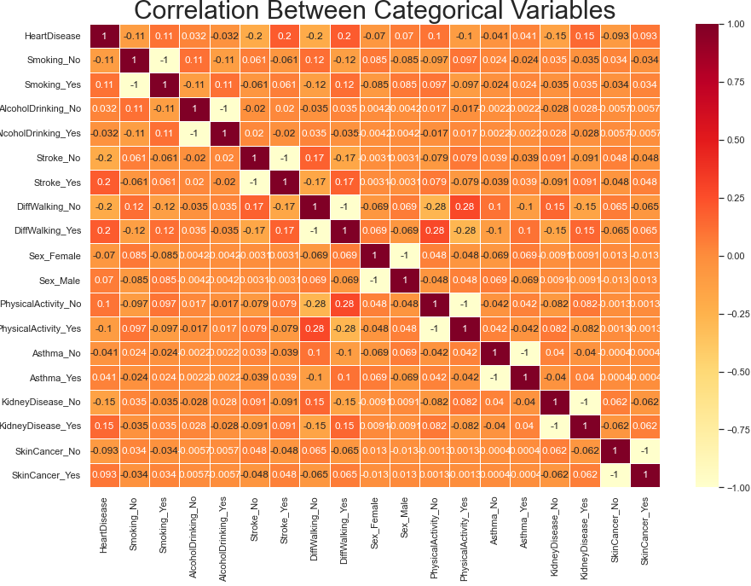
Being stroke patient to have a heart disease, a person who smokes , a person who have less physical activities , person who have kidney disease shows a positive correlation with the target variable.
Alcohol drinking shows very low negative correlation with the target variable
Skin cancer and Asthma shows no correlation with the target variable

Slide 13
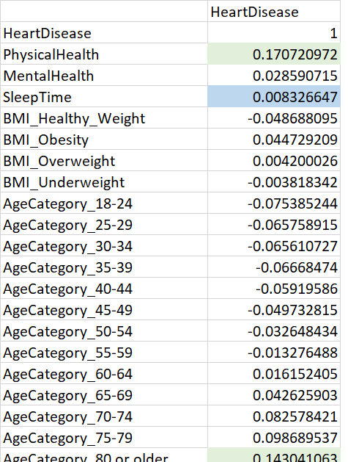
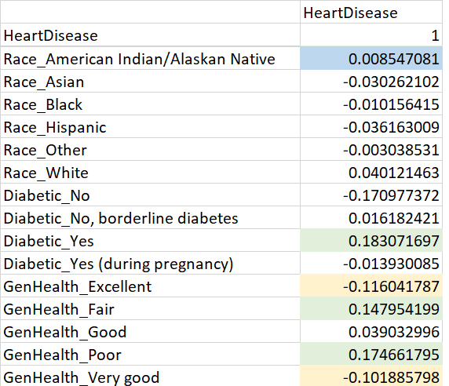
Correlation Between Continuous Variables
Physical health , being a diabetic patient , Poor general health , Age category above 80 years show a lower positive correlation with the target variable.
Excellent and very good general health shows lower negative correlation.
Sleep time , Race shows no correlation.

Slide 14
DATA STORAGE

Slide 15
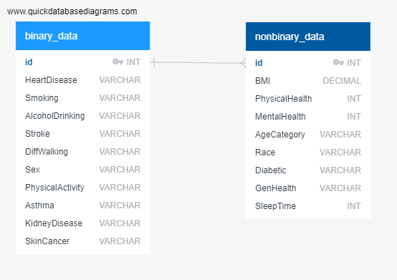
Creating tables for binary and nonbinary data using SQL
Joining tables using id number as the primary key
Storing data using Pgadmin

Slide 16
MACHINE LEARNING MODELS

Slide 17
Logistic Regression Model | Random Forest Classifier
Splitting the data into training and testing Create logistic regression model Fit train or model using the training data Make Predictions Validate the model using the test data | Preprocess the data Fit the random forest model Make predictions using the testing data Evaluate the model Rank the importance of features

Slide 18
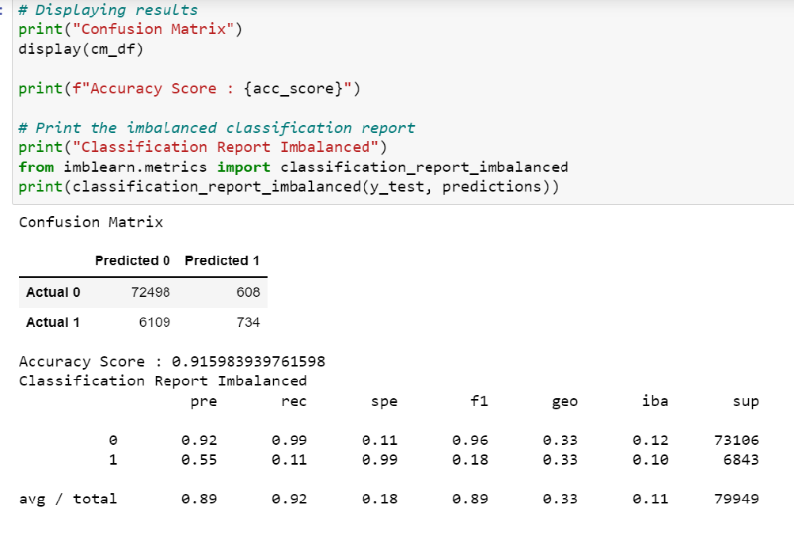
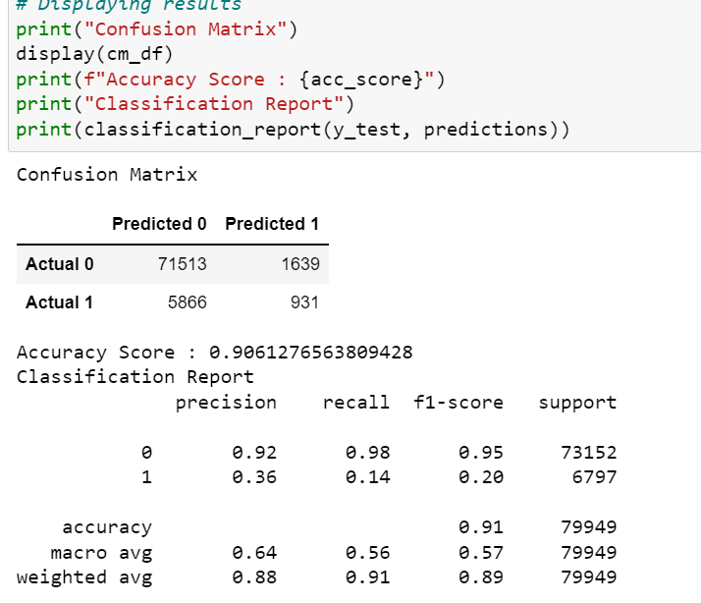
Logistic Regression and Random Forest Classifier

Slide 19
DASHBOARD

Slide 20
Dashboard Elements
For the dashboard segment ,we have used Tableau Public and please click here view the interactive dashboard embed.
Number of people with heart disease will be the key element of the dashboard and how it interacts with other elements such as alcohol drinking, Diabetic, Kidney Disease and Asthma will be shown on the dashboard.

Slide 21
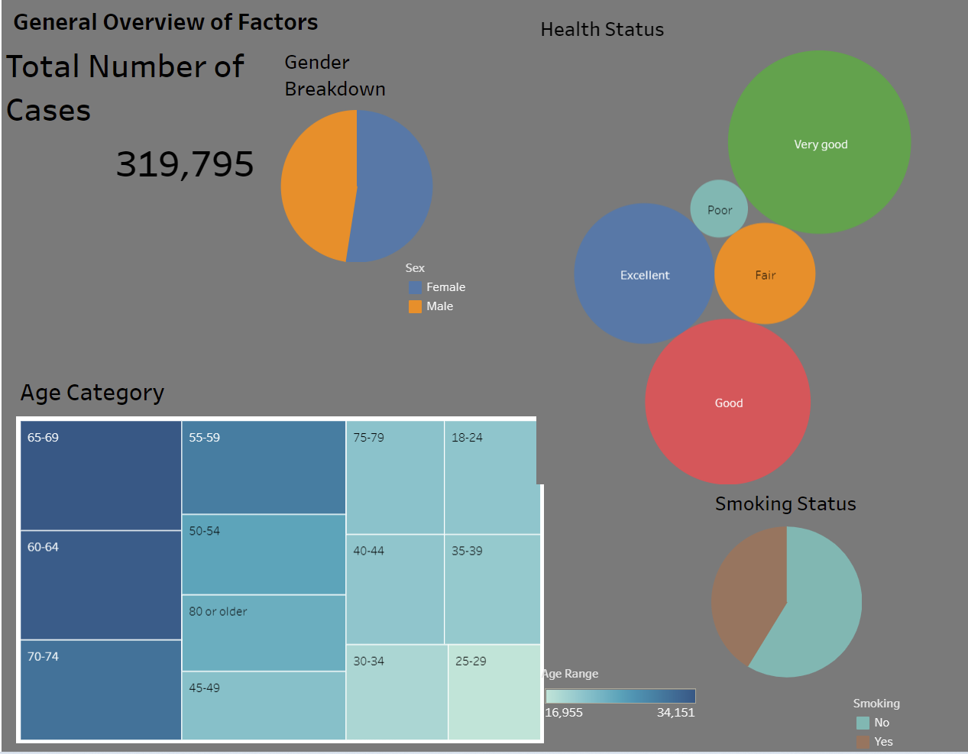
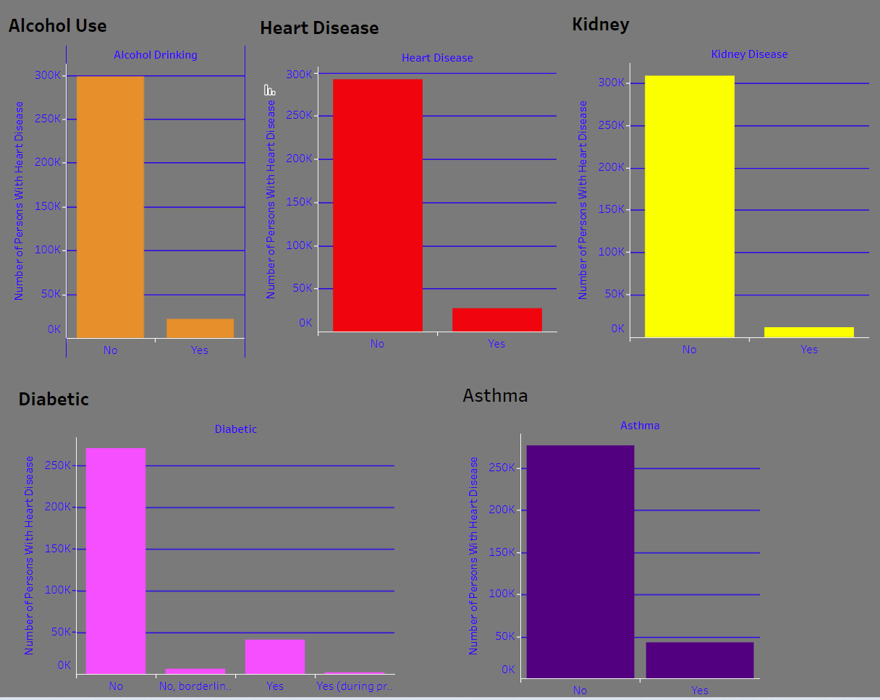
The graph below shows the diagram of how alcohol use, being a kidney patient, being a diabetic patient and being a Asthma patient vs the number of persons with heart disease or number of persons with not heart disease.
The general overview of factors image shows the gender breakdown , health status , age category and smoking status from the total number of persons in the list.

Slide 22
CONCLUSION

Slide 23
After completing the project we will be analysing our machine learning models we created.
We will be considering designing and training deep learning neural network model based on the final analysis output.

Slide 24








The Team
Ethan McBride
Andres Pombo
Sergei Zhukov
Marian Salgadoe
Thank you

